Slide 1

DO NOW
Name 4 types of continuous data
Name 4 types of discreet data
Name 4 types of categorical data
Find the mean, median, mode and range:
1, 4, 5, 12, 14, 3, 17, 20, 21, 1, 4, 2, 7, 13
Activate Prior Knowledge

Slide 2
Explain the difference between differential statistics and inferential statistics
Activate Prior Knowledge

Slide 3

Learning Intentions
I will be able to describe different extraneous variables
I will be able to identify and execute the steps required to write the discussion, conclusion and references of my investigation.
Success Criteria
I will add to my notes on extraneous variables
I will apply the steps to my investigation - writing a discussion, conclusion and references.

Slide 4
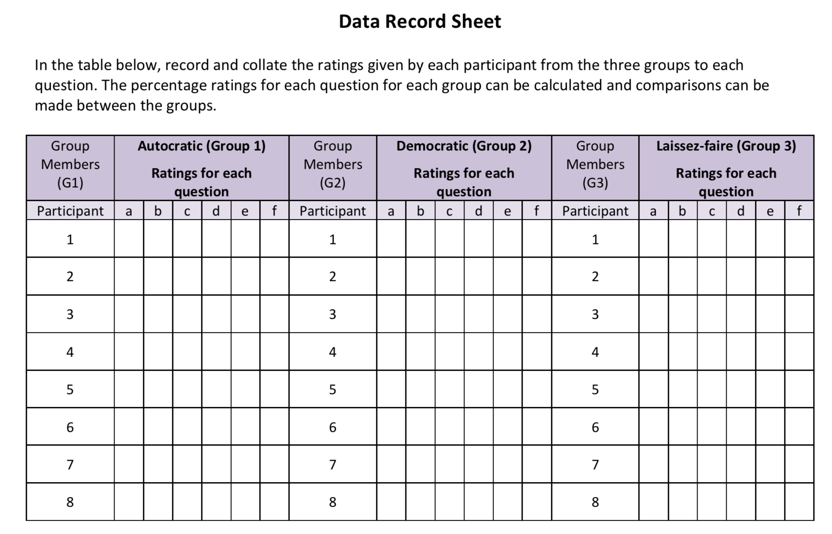
Data collection: Results section
Assessment tips!
Use a ruler and pencil Label the headings for columns and rows Label the table with Table 1. and a title
Step 1: all of your should create your table on Excel / Numbers
Or pages like below:
Skill Development: Results section
Table1. To show the ___________________________________
Questions from the survey
Question 1.
How understood and listened to did you feel in your group?
Question 2
How much influence do you feel you had in your group’s decision making?
Question 3
How committed do you feel to the decisions your group made

Slide 5
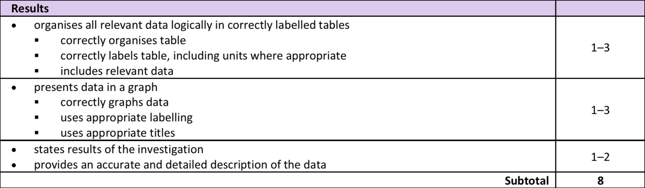
Data collection: Results section
Assessment tips!
Use a ruler and pencil Label the headings for columns and rows Label the table with Table 1. and a title
Skill Development: Results section

Slide 6
Assessment tips!
Use a ruler and pencil Label the headings for columns and rows Label the table with Graph 1. and a title Remember to put units in
Data collection: Graphing results
Skill Development: Results section
Step 1: Choose an appropriate graph. What type of data have we collected?
Step 2: Choose an appropriate scale, how big does it need to be to be clear?
Step 3: Draw and label the X and Y axis
Step 4: Plot your data
Step 5: Label your graph with both variables mentioned

Slide 7
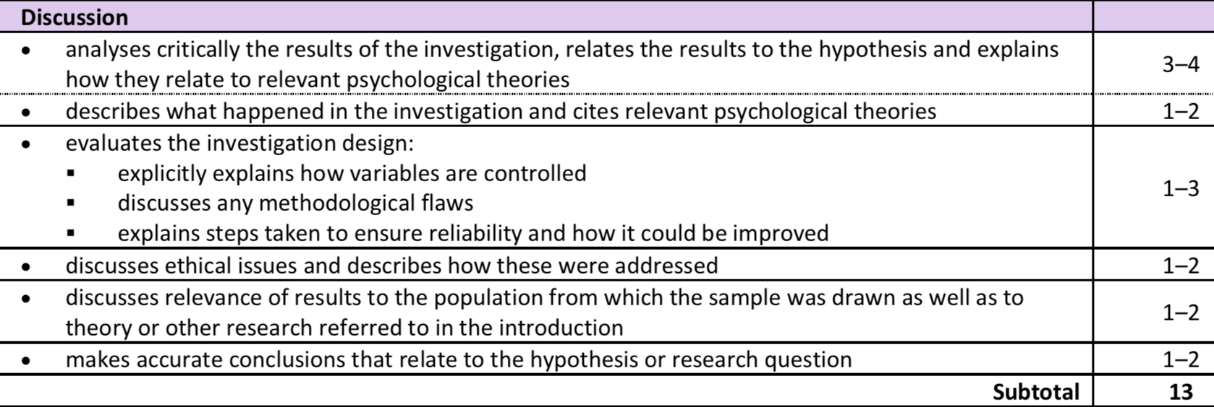
Discussion
Skill development
Step 1: Restate the hypothesis for the experiment.
Step 2: State whether the hypothesis was supported or rejected
Step 3: Refer to your results to explain why it was supported or rejected to draw conclusions.
Step 4: Relate to previous research (similar findings or not?)

Slide 8
Discussion
Skill development
Step 5: Discuss at least two limitations of study design and suggest how to improve.
Limitations may include:
Not controlling for extraneous variables.
Not a valid measure of mood or sufficient exercise to create changes in mood.
Not enough experimental conditions.
The placebo of relaxation was not a valid activity to constitute as a placebo.
Not reliable/consistent.
Not a representative sample or appropriate participant allocation method.

Slide 9
Discussion
Skill development
Step 6: How were ethical issues addressed –(participant rights)
Step 7: Relate this back to the introduction – why are these results relevant to the population you researched?
Step 8: Conclusions that relate to the hypothesis

Slide 10
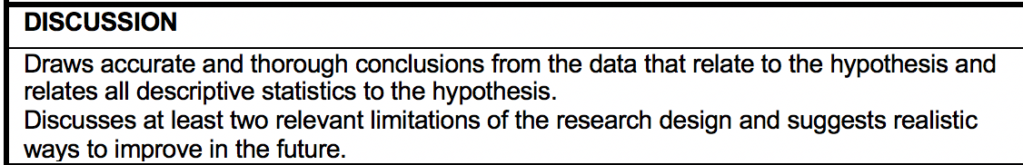
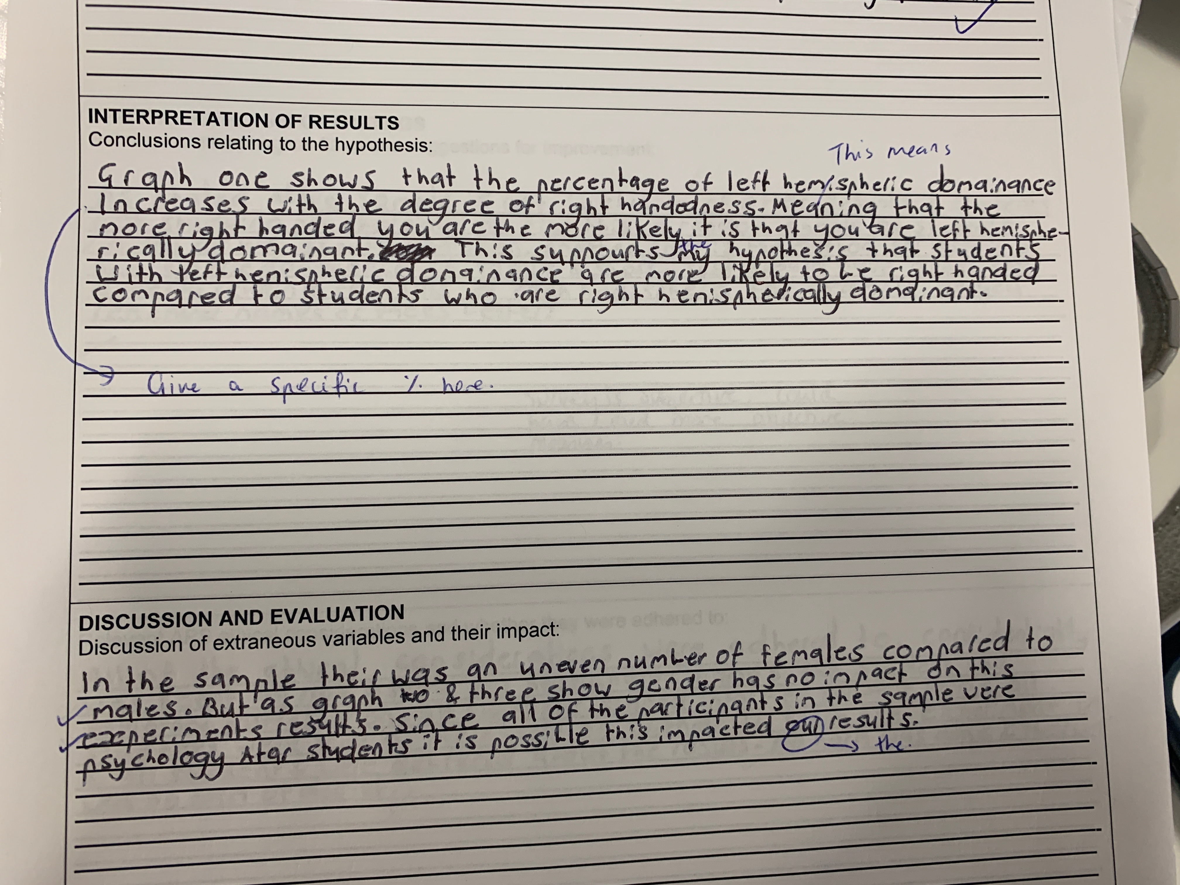
What is good?
What should be improved?

Slide 11
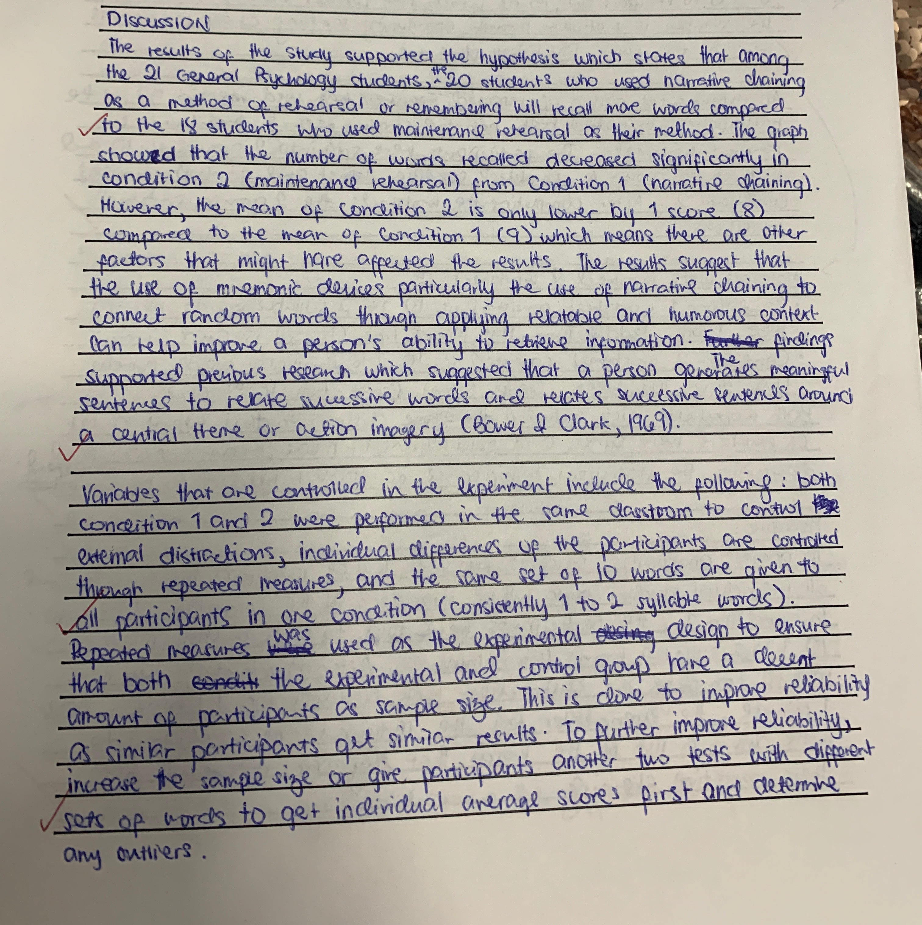
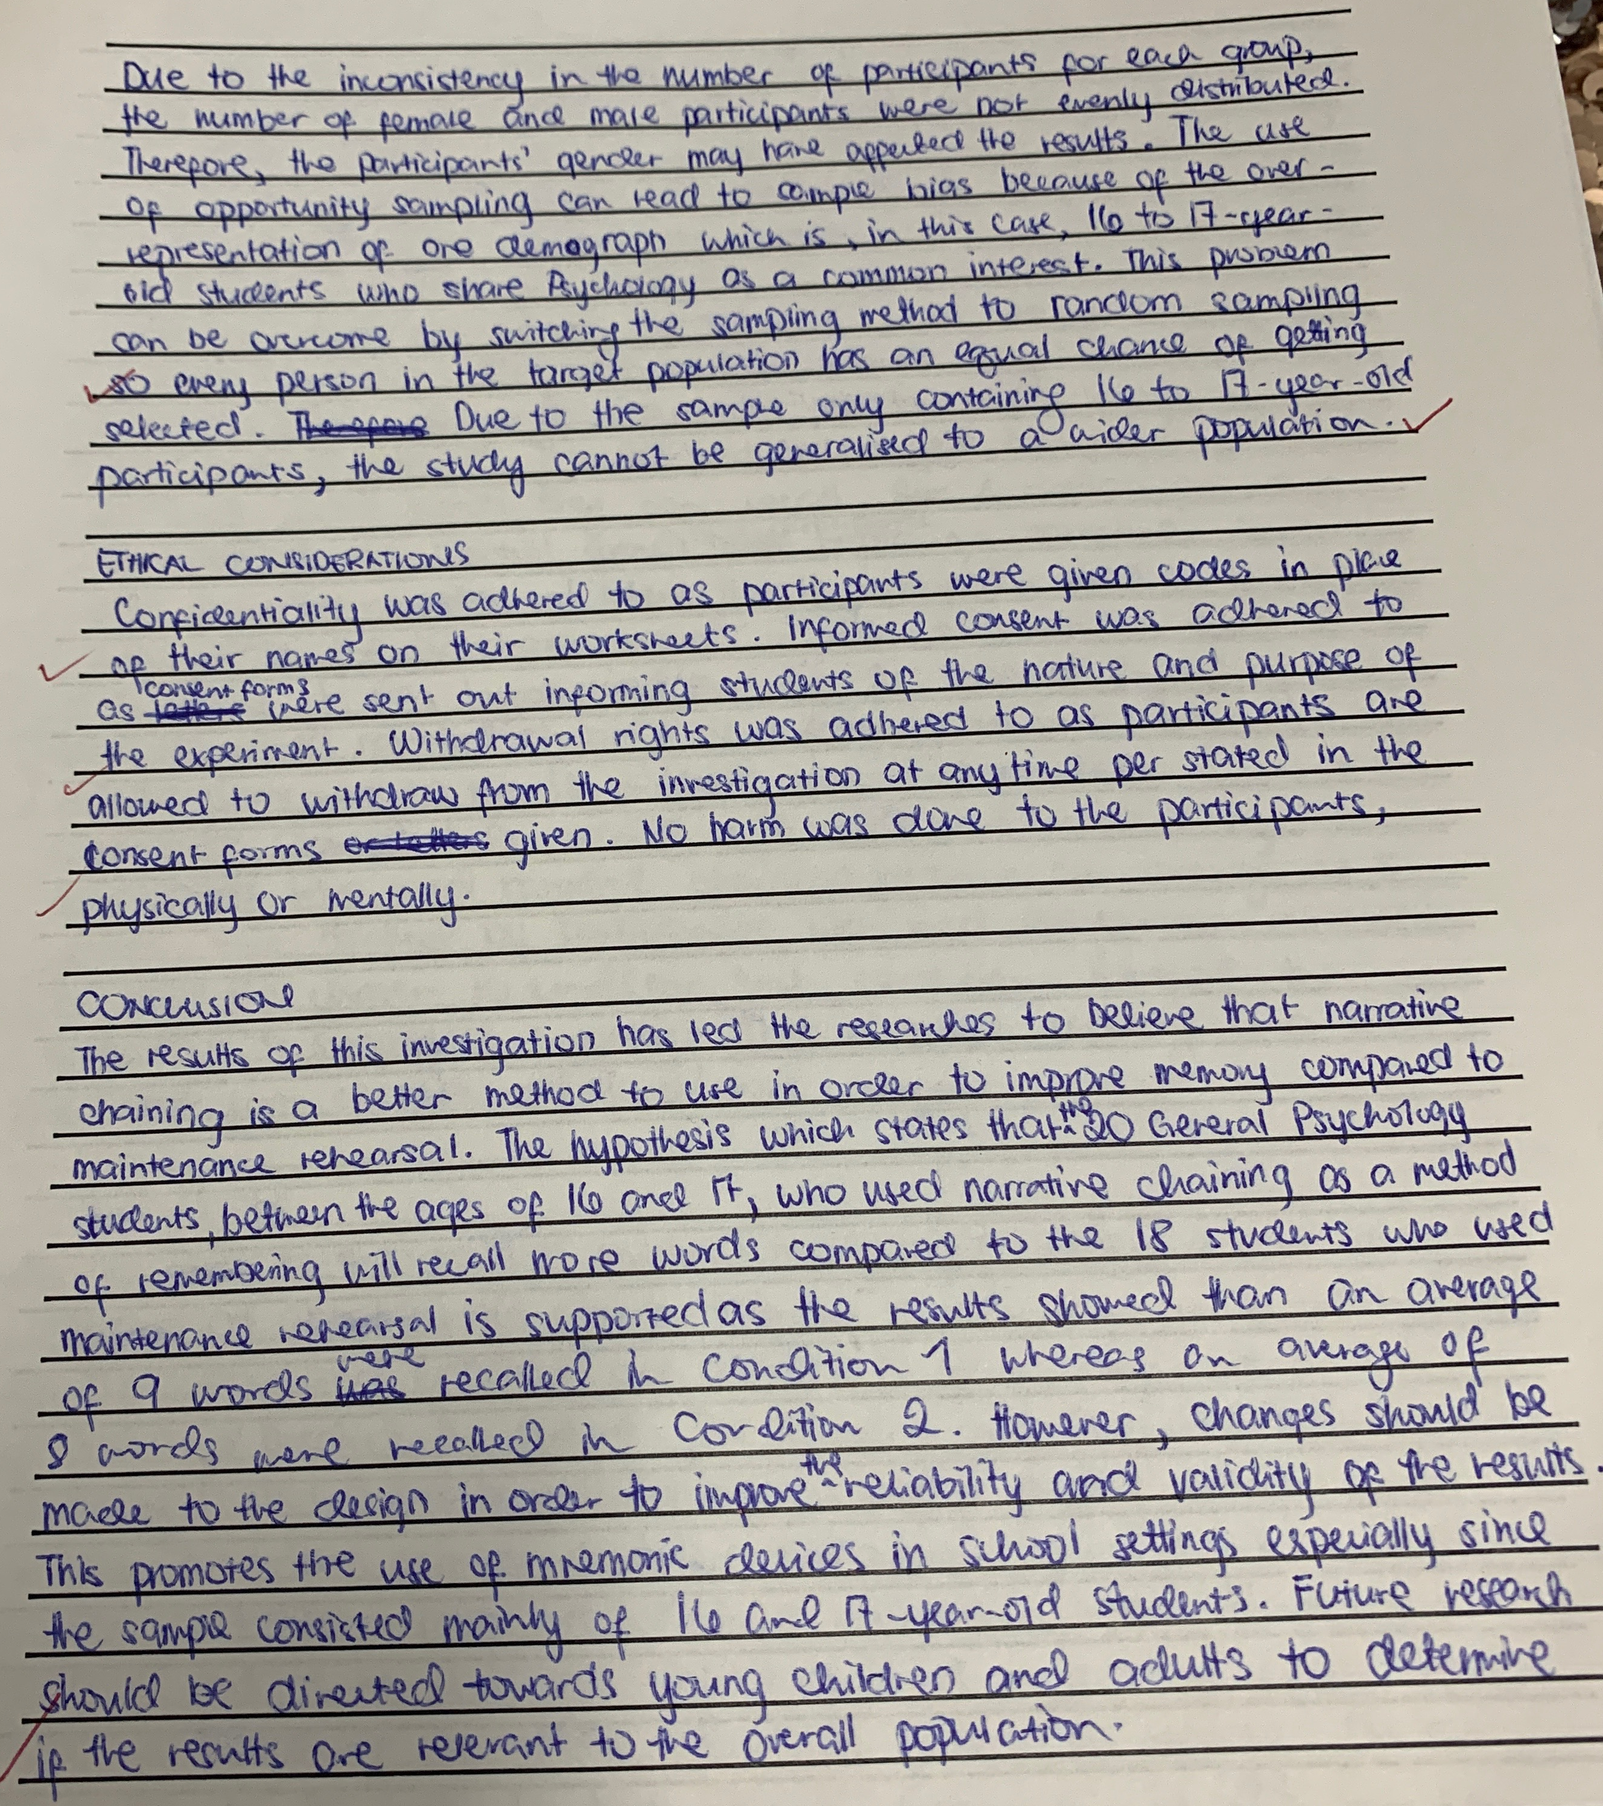

Slide 12
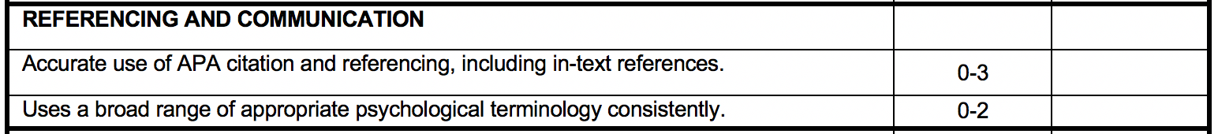
Referencing
Skill development
Make sure your submit a reference list at the end of your investigation report (in alphabetical order).
Don’t forget that you need to write in-text references as well at the end of a sentence the reference was used.
Example
In text:
According to the Australian Psychological Society (2008), substance abuse is…
or
Substance abuse is a series issue for mental health (Australian Psychological Society, 2008).
Reference for the reference list:
Australian Psychological Society. (2008). Substance abuse: Position statement. Retrieved from http://www.psychology.org.au/publications/statements/substance/

Slide 13
Referencing
Skill development
Other examples
SOURCE | How to reference at the end of the text
Web page | Australian Psychological Society. (2008). Substance abuse: Position statement. Retrieved from http://www.psychology.org.au/publications/statements/substance/
Web page: No author | Improve indigenous housing now, governments told. (2007). Retrieved from http://www.raia.com.au/i-cms?page=10220
Web page: No date | Jones, M. D. (n.d.). Commentary on indigenous housing initiatives. Retrieved from http://www.architecture.com.au
Journal article | Myre, A. S., & Door, H. (2011). The effect of mental well-being on education outcomes. Journal of Educational Psychology, 51(3), 1138-1139. Retrieved from http://www.architecture.com.au

Slide 14
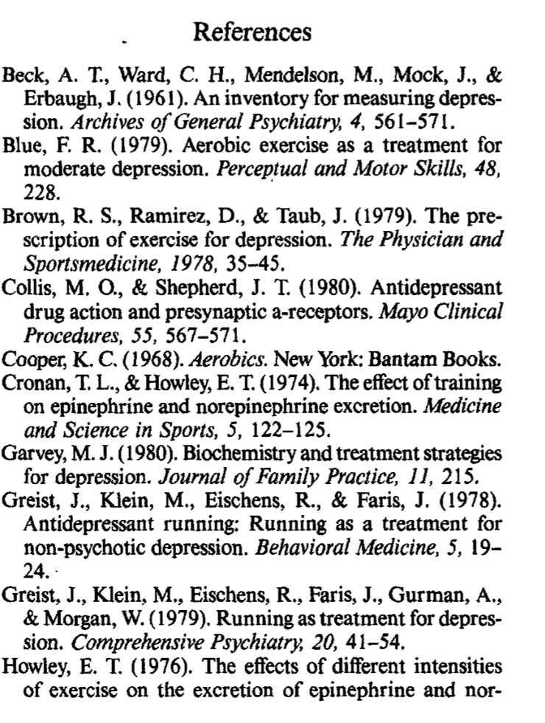
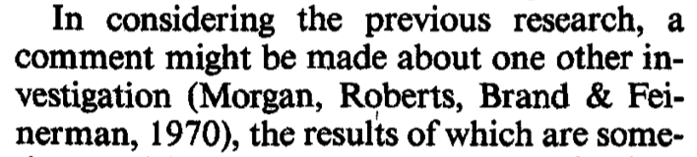
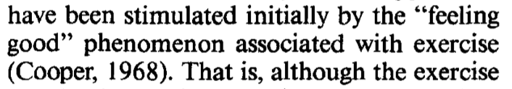
Referencing
Skill development
In-text
Referencing List

Slide 15

Homework
Before your next lesson, you must have:
DRAFTED YOUR DISCUSSION AND CONCLUSION
If you need support message me on SEQTA.

